Slide 1
UbiComp 2022
Guard Your Heart Silently: Continuous Electrocardiogram Waveform Monitoring with Wrist-Worn Motion Sensor
Yetong Cao∗ Fan Li∗ Huijie Chen† Xiaochen Liu∗ Li Zhang‡ Yu Wang§
*School of Computer Science, Beijing Institute of Technology, China
† School of Computer Science, Beijing University of Technology, China
‡ School of Mathematics, Hefei University of Technology, China
§Department of Computer and Information Sciences, Temple University, USA

Slide 2
Background
Emotion Recognition
Biometric Identification
Electrocardiogram (ECG) measures the electrical activity of the heart, which has a unique waveform shape associated with cardiac cycles
Physiological Metrics Monitoring

Slide 3
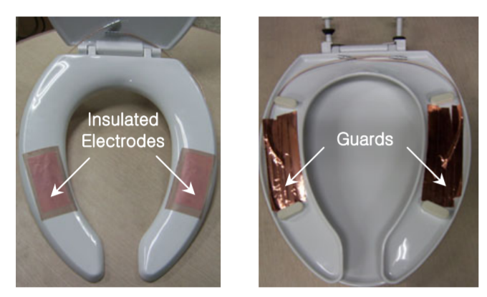
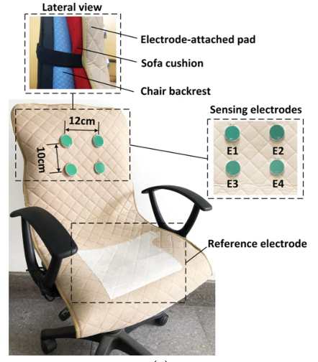
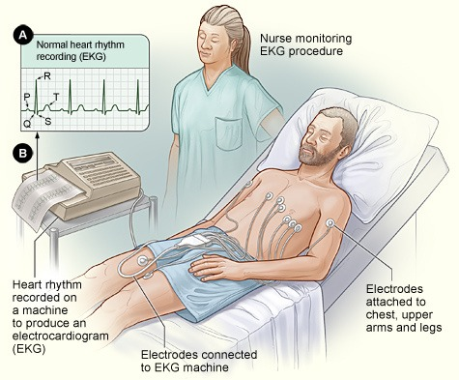
Current ECG Monitoring Solutions
Clinical Monitors
Household Monitors
Inconvenient

Slide 4
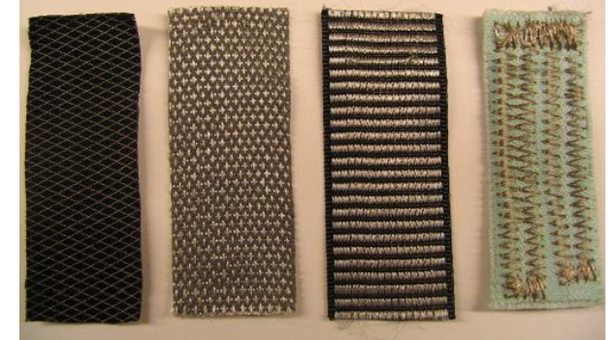
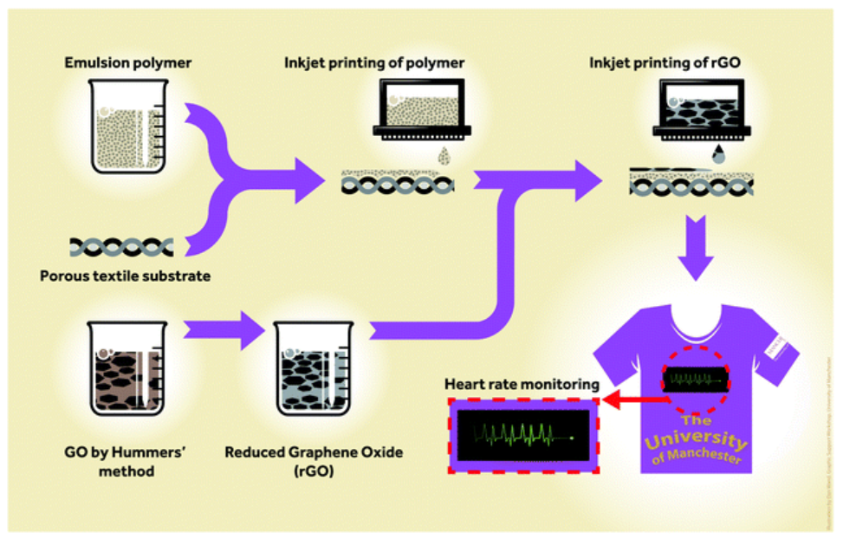
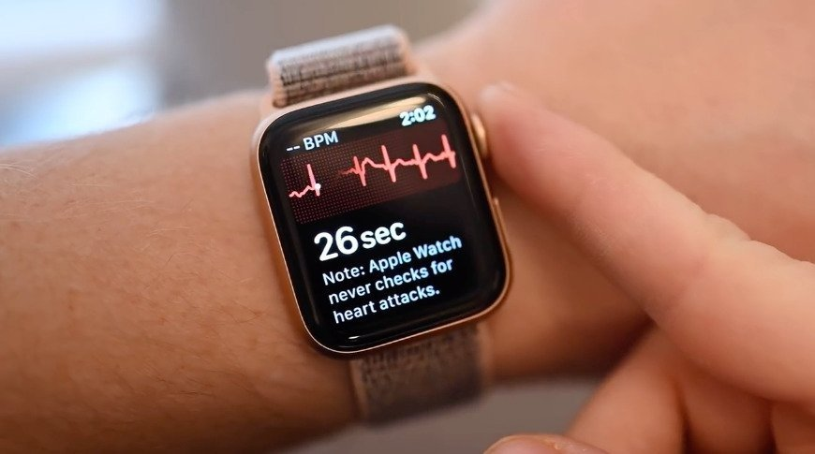
Current ECG Monitoring Solutions
Wearable approaches
Expensive
Discontinuous

Slide 5
Our Solution
We propose VibCardiogram
Low-Cost
Motion Sensor
Continuous
Convenient
VibCardiogram
Unobtrusive
Wrist-worn devices
Reliable

Slide 6
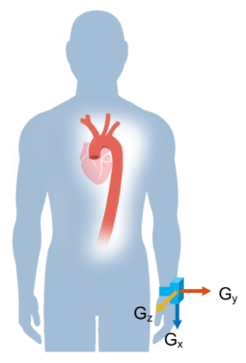
Observation: Cardiogenic Body Vibrations

Slide 7
VibCardiogram : Overview & Challenges
Challenge 1：
How to disentangle the wrist vibration induced by cardiac activities from noisy sensor data collected at the wrist?
Challenge 2：
How to segment each heartbeat in the complex cardiogenic body vibrations?
Challenge 3：
How to achieve accurate and fine-grained ECG waveform shape estimation

Slide 8
VibCardiogram : Wrist Vibration Extraction
Signal Preprocessing
Bandpass filtering (4th-order Butterworth, [5 Hz-30 Hz])
Linear interpolation
Movement Noise Cancellation
Stable
Periodic
Noisy
Non-periodic

Slide 9
VibCardiogram : Wrist Vibration Extraction
Signal Preprocessing
Bandpass filtering (4th-order Butterworth, [5 Hz-30 Hz])
Linear interpolation
Movement Noise Cancellation
Stationary Wavelet Transform (SWT)-based noise reference generation
Interference
reference

Slide 10
VibCardiogram : Wrist Vibration Extraction
Signal Preprocessing
Bandpass filtering (4th-order Butterworth, [5 Hz-30 Hz])
Linear interpolation
Movement Noise Cancellation
Stationary Wavelet Transform (SWT)-based noise reference generation
Adaptive filter-based noise cancellation
Cardiogenic body vibrations

Slide 11
VibCardiogram : Vibration Signal Segmentation
Spike Point Identification
R peak

Slide 12
VibCardiogram : Vibration Signal Segmentation
Spike Point Identification
Detect all local maximum/minimum points in the vibration signal

Slide 13
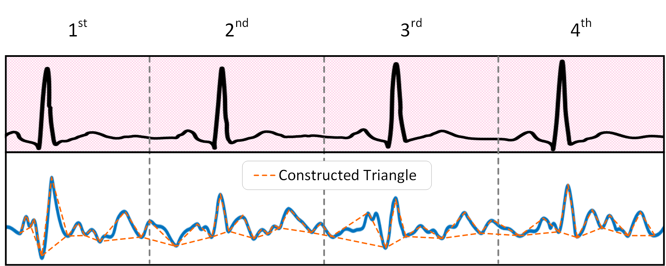
VibCardiogram : Vibration Signal Segmentation
Spike Point Identification
Constructed triangles based on local maximum (peak) and its two adjacent local minimums (trough)

Slide 14
VibCardiogram : Vibration Signal Segmentation
Spike Point Identification
Extract geometric features in each triangle

Slide 15
VibCardiogram : Vibration Signal Segmentation
Spike Point Identification
Compare feature correlations and select $a+b,d,e,f$ to input into the random forest to identify spike points
Feature | Spike points |  |  | Other points
 | AVG | MED | STD | AVG | MED | STD
a+b | 1.221 | 1.165 | 0.384 | 0.427 | 0.349 | 0.104
c | 0.160 | 0.150 | 0.004 | 0.093 | 0.08 | 0.004
d | 0.470 | 0.433 | 0.009 | 0.221 | 0.150 | 0.046
e | 0.738 | 0.803 | 0.238 | 0.189 | 0.094 | 0.061
f | 0.385 | 0.324 | 0.043 | 0.848 | 0.698 | 0.295
g | 0.971 | 0.491 | 0.954 | 1.253 | 1.364 | 0.815
h | 1.355 | 0.840 | 1.064 | 1.041 | 0.574 | 0.985

Slide 16
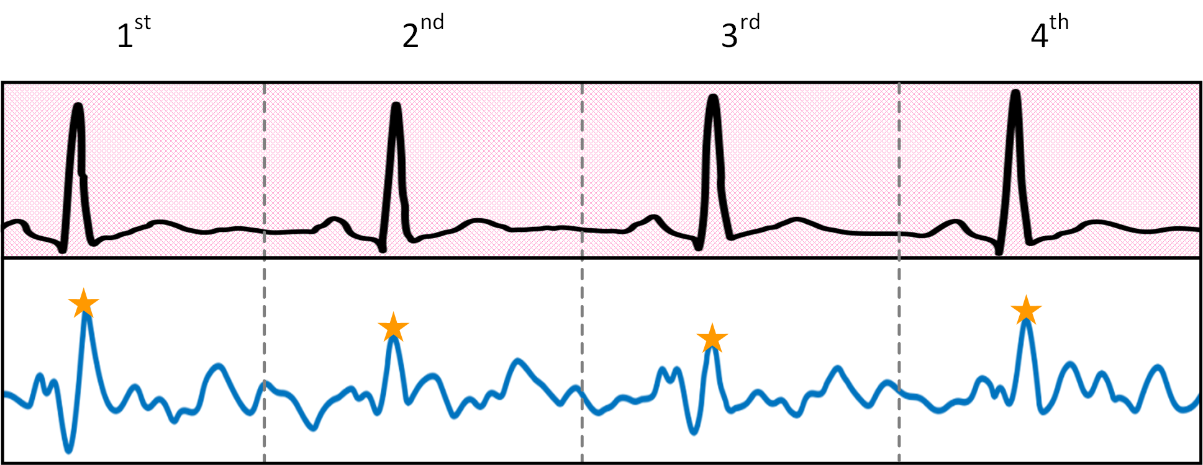
VibCardiogram : Vibration Signal Segmentation
Heartbeat Fragment Extraction
Identify the 250 ms before the spike point as the boundary of a heart cycle
250 ms
250 ms
250 ms

Slide 17
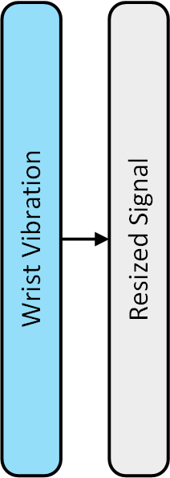
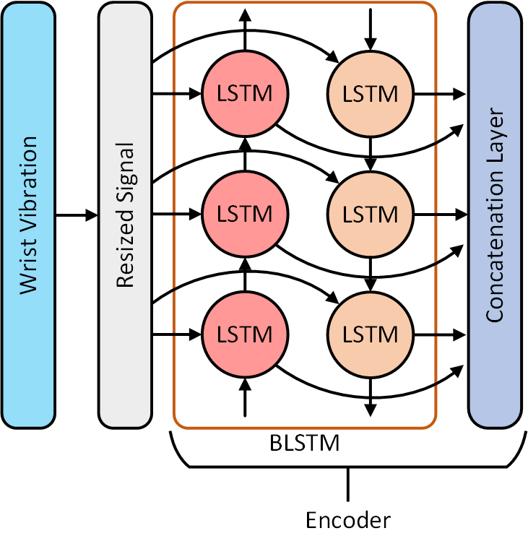
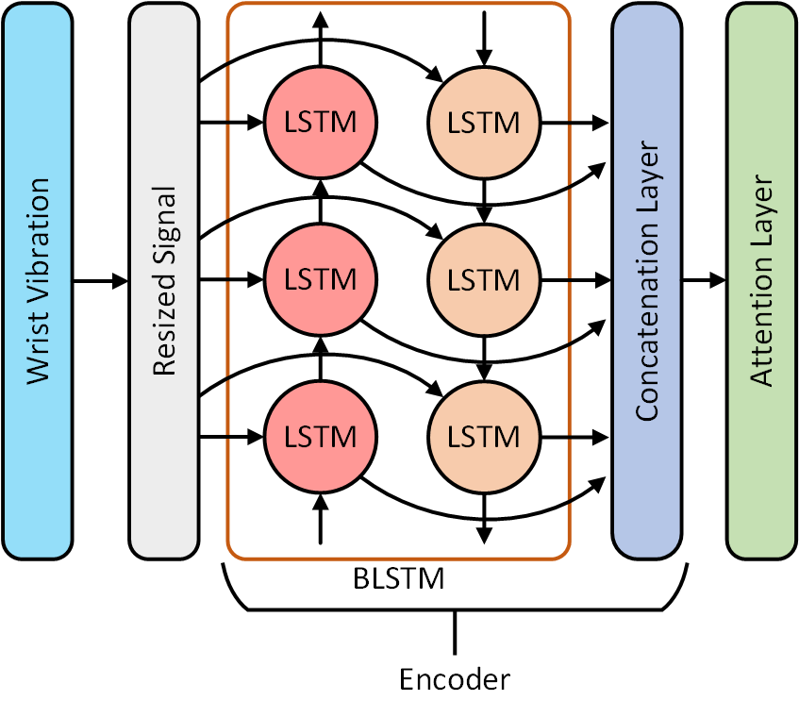
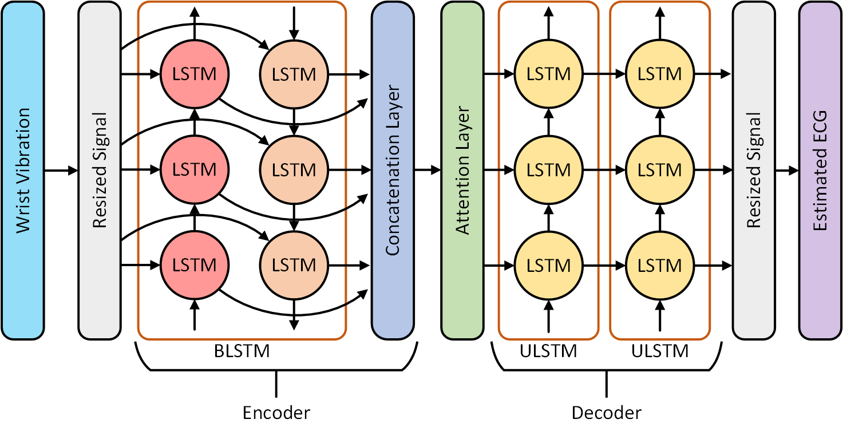
VibCardiogram : ECG Estimation
Encoder-Decoder Model Building

Slide 18
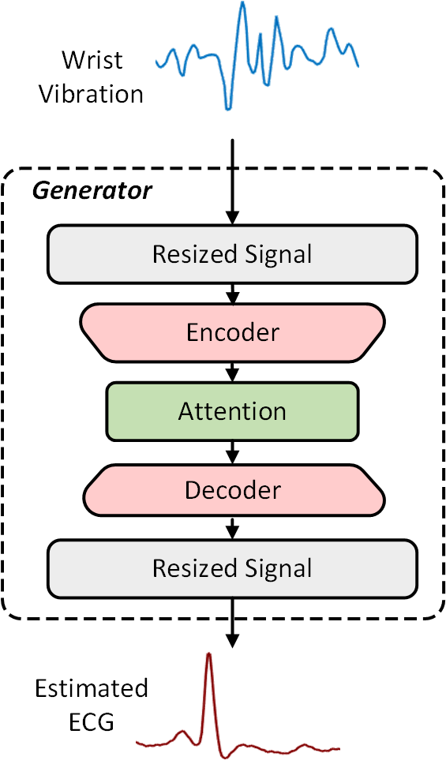
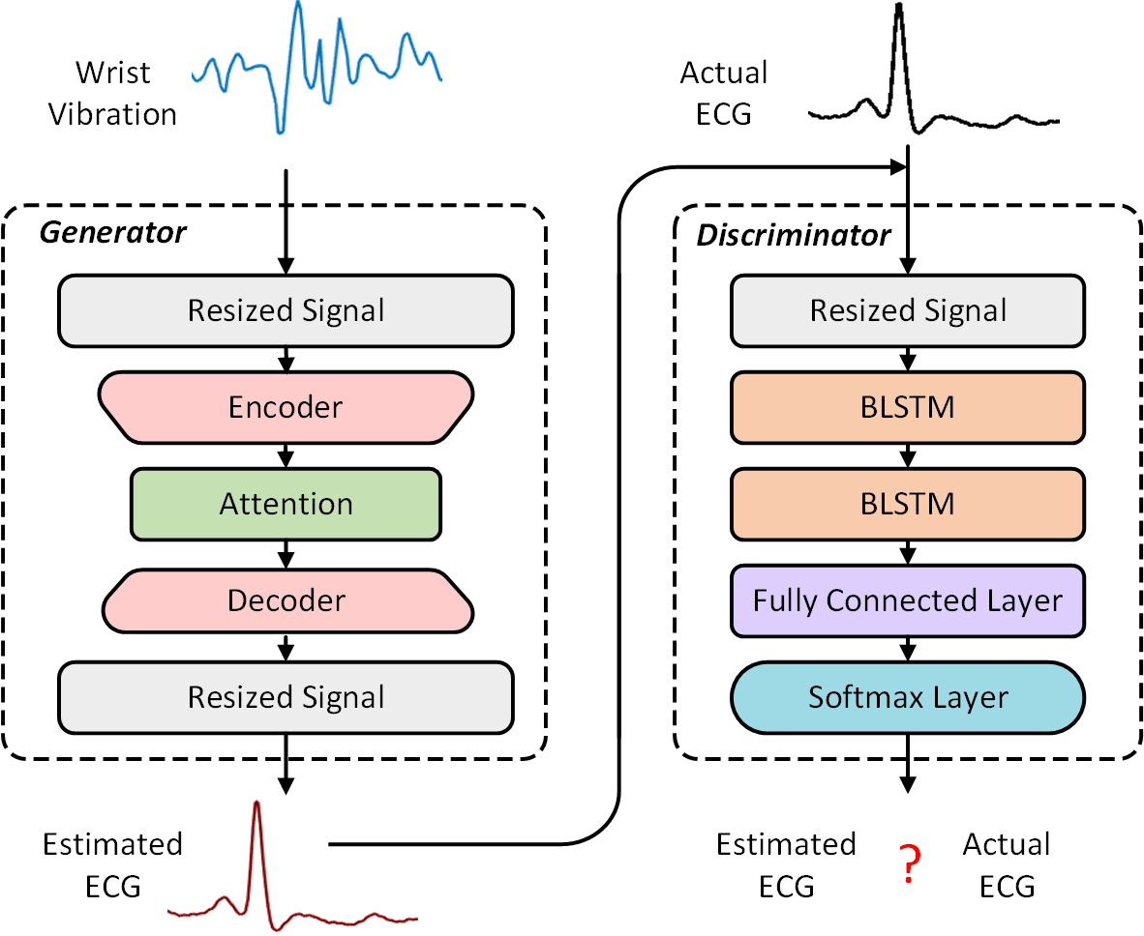
VibCardiogram : ECG Estimation
Encoder-Decoder Model Boosting
$$Loss=L_{e}+L_{a}$$
Loss of generator:
$$L_{e}=\frac{1}{L}\sum_{i=1}^{L}{\frac{|A_{i}−E_{i}|}{A_{i}}}$$
Loss of discriminator:
$$L_{a}=\log{[1−P_{EA}]}$$

Slide 19
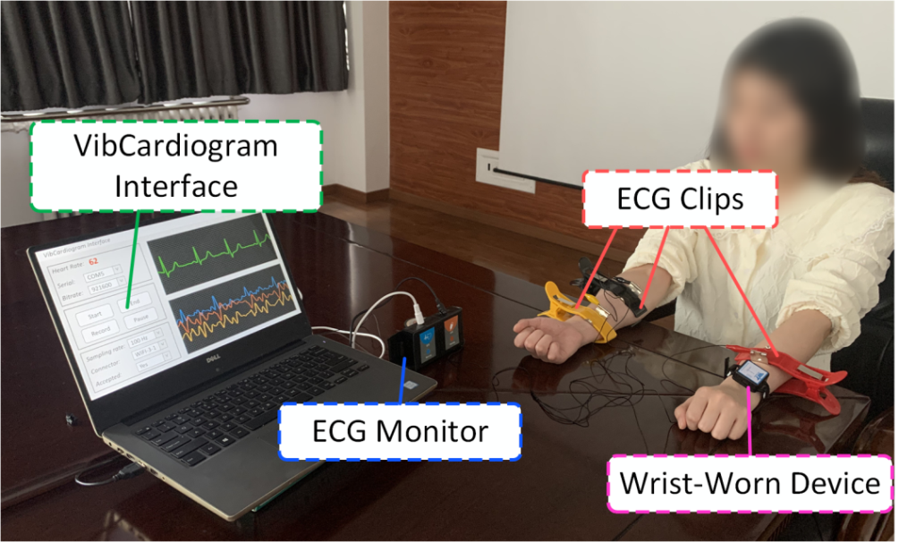
Evaluation
Setup
IMU prototype
Data Collection
20 participants (10 male,10 female)
Various body movements, sampling rates, sensor positions
Ground Truth
AD8232-based device
Metrics
Estimation Error: $\frac{1}{L}\sum_{i=1}^{L}{\frac{|A_{i}−E_{i}|}{A_{i}}}$
Correlation Coefficient:$\frac{(E−\overline{E})(A−\overline{A})}{\sqrt{{(E−\overline{E})}^{2}}\sqrt{{(A−\overline{A})}^{2}}}$
Adjustable wrist band
IMU

Slide 20
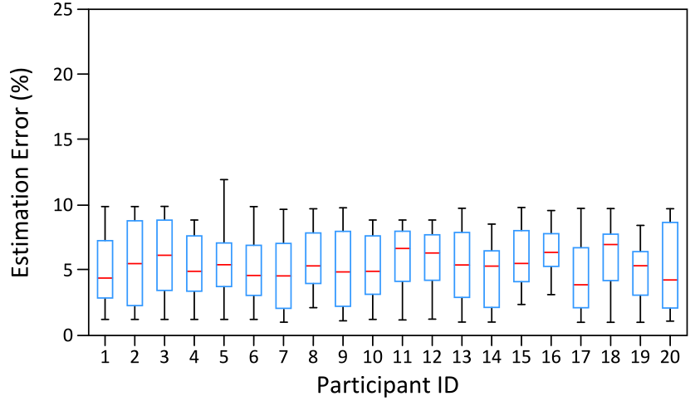
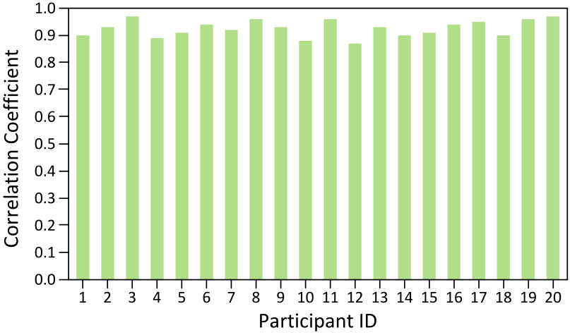
Evaluation: Overall Performance
75% data for training and the rest 25% data for testing
Estimation Error:
Average 5.989% 2.496%
Correlation Coefficient:
Average 0.926 0.030
$$∓$$
$$∓$$

Slide 21
Evaluation: Emotion Recognition
Stimuli emotions using video clips
Estimate ECG waveform
Extract HRV features
Classify emotion using SVM
Comparison of our method with typical methods in emotion recognition

Slide 22
Conclusion
We propose the first IMU-based wearable ECG waveform estimation system that achieves low-cost, continuous, reliable, convenient, and unobtrusive
We design a set of techniques to ensure accurate ECG estimation
Evaluation Results are promising
More details？
Yetong Cao, Fan Li, Huijie Chen, Xiaochen Liu, Li Zhang, Yu Wang,
Guard Your Heart Silently: Continuous Electrocardiogram Waveform Monitoring with Wrist-Worn Motion Sensor,

Slide 23
Thanks!
Thanks!
Thanks!
&
&
&
Questions
Questions
Questions
Yetong Cao
yetongcao@bit.edu.cn

